Slide 1
Authenticate and connect with Microsoft Graph
Scopes and consent in the v2.0 endpoint

Slide 2

Scopes and consent in the v2.0 endpoint
Scopes-and-permissions
OpenID Connect scopes
Delegated vs Application permissions
Microsoft Graph permission names
Individual user consent
Admin consent
Dynamic consent

Slide 3

Scopes-and-permissions
Web-hosted resources that integrate with Azure AD have a resource identifier (Application ID URI)
Office 365 Unified Mail API: https://outlook.office.com
Azure AD Graph API: https://graph.windows.net
Microsoft Graph: https://graph.Microsoft.com
Resources define permissions
Calendar.Read
Profile.ReadWrite
Mail.Send
Notes:
In Azure AD and OAuth, these types of permissions are called scopes.

Slide 4
OpenID Connect scopes
 | What it does | Work or school account consent page | Microsoft account consent page
openid | Allows your app to sign the user in and receive an app-specific identifier for the user. | Sign in as you | Sign you in
email | Allows your app access to the user’s primary email address via the email claim in the token. | View your email address | View your email address
profile | Allows your app access to all other basic information such as name, preferred username, object ID, and others. | View your basic profile | View your basic profile
offline_access | Enables retrieving refresh tokens and silently updating access tokens. | Access your data anytime | Access your info anytime

Slide 5
Delegated vs Application permissions
Delegated permissions
Used by apps that have a signed-in user present
Application permissions
Used by apps that run without a signed-in user present
User
App
User
App
Effective permissions
Effective permissions
Notes:
For delegated permissions, the effective permissions of your app will be the least privileged intersection of the delegated permissions the app has been granted (via consent) and the privileges of the currently signed-in user. Your app can never have more privileges than the signed-in user.
For application permissions, the effective permissions of your app will be the full level of privileges implied by the permission. For example, an app that has the User.ReadWrite.All application permission can update the profile of every user in the organization.

Slide 6
Microsoft Graph permission names
Resource.Operation.Constraint
Constraint | What it does
All | Grants permission for the app to perform the operations on all of the resources of the specified type in a directory.
Shared | Grants permission for the app to perform the operations on resources that other users have shared with the signed-in user. This constraint is mainly used with Outlook resources like mail, calendars, and contacts.
AppFolder | Grants permission for the app to read and write files in a dedicated folder in OneDrive. This constraint is only exposed on Files permissions and is only valid for Microsoft accounts.
none | If no constraint is specified the app is limited to performing the operations on the resources owned by the signed-in user.
Notes:
Permission names for Microsoft Graph follow the pattern Resource.Operation.Constraint.
All: For example, User.Read.All potentially grants the app privileges to read the profiles of all of the users in a directory.
Shared: For example, Mail.Read.Shared, grants privileges to read mail in the mailbox of the signed-in user as well as mail in mailboxes that other users in the organization have shared with the signed-in user.
(none): For example, User.Read grants privileges to read the profile of the signed-in user only, and Mail.Read grants permission to read only mail in the mailbox of the signed-in user.

Slide 7

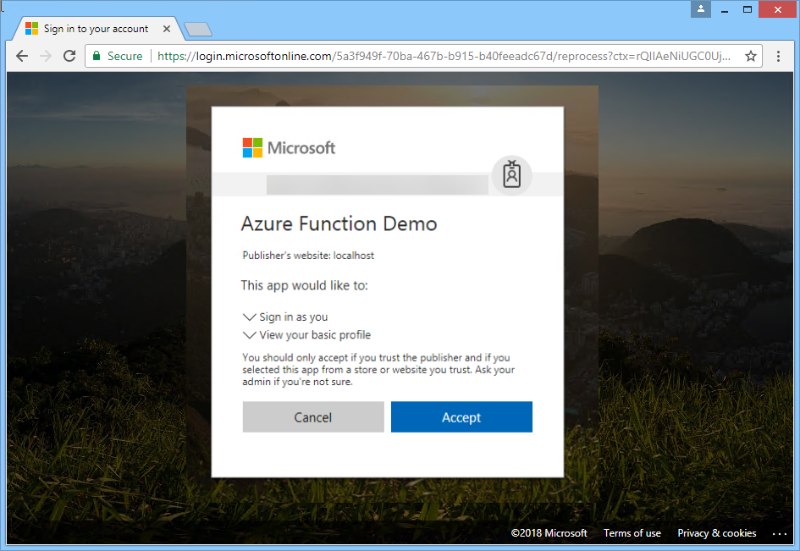
Requesting individual user consent
Notes:
Some permissions do not require admin consent, each individual can individually grant consent for an application.

Slide 8
Permission scope was not requested
HTTP/1.1 403 Forbidden
Cache-Control: private
Transfer-Encoding: chunked
Content-Type: application/json
request-id: e2881ae0-1790-4387-b49a-a4231b4c295d
client-request-id: e2881ae0-1790-4387-b49a-a4231b4c295d
Duration: 70.1988
Date: Mon, 26 Jul 2017 12:02:18 GMT
{
"error": {
"code": "Authorization_RequestDenied",
"message": "Insufficient privileges to complete the operation.",
"innerError": {
"request-id": "e2881ae0-1790-4387-b49a-a4231b4c295d",
"date": "2017-07-26T12:02:18"
}
}
}
Notes:
If the application attempts an operation that was not in the original permission request, the user did not grant consent and an HTTP 403 is returned.
Example: scope requested is User.Read, operation requested is /mail/Send. Will fail because the Mail.Send permission was not requested and granted.

Slide 9
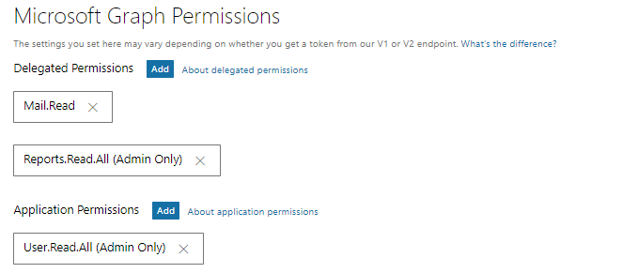
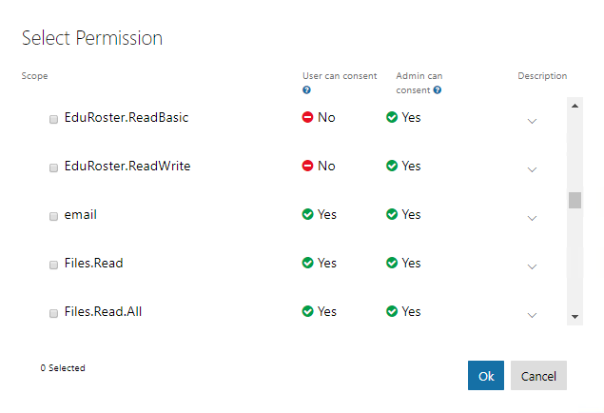
Example Microsoft Graph permissions
Notes:
There are more resources, this is just a small sample. See https://developer.microsoft.com/en-us/graph/docs/concepts/permissions_reference
The portal allows you to specify which permissions an app will need. This section is only used for admin consent. An application can dynamically request additional permissions so long as the requested permission does not require admin consent. In this example, the application has requested:
Delegated Mail.Read – does not require admin consent
Delegated Reports.Read.All – requires admin consent
Application User.Read.All – requires admin consent

Slide 10
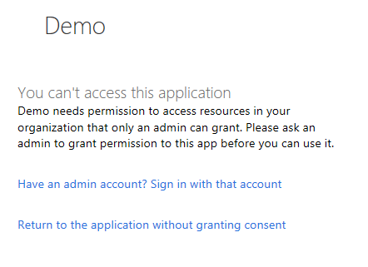
User lacks permission for requested scope
Notes:
Some operations require an administrator to consent. If a non-admin user attempts to use an application that requests permissions requiring admin consent, an error is shown to the user.

Slide 11
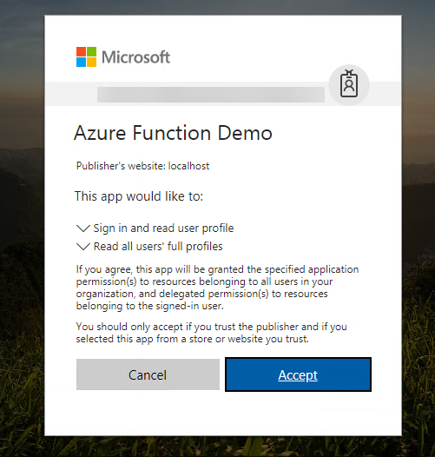
Requesting admin consent
https://login.microsoftonline.com/common/adminconsent
?client_id=0777388d-640c-4bc3-9053-671d6a8300c4
&state=12345
&redirect_uri=http://localhost/myapp/permissions
Notes:
An admin can pre-consent to the permissions for all users in the organization for delegated permissions.
Note the text at bottom: If you agree, this app will be granted the specified application permission(s) to resources belonging to all users in your organization, and delegated permission(s) to resources belonging to the signed-in user.
If an application requires additional permissions that require admin consent, can direct user to the admin consent URL where they will have to log in as a user with administrative privileges.

Slide 12
Dynamic consent
[Authorize]
public async Task<ActionResult> SendMail()
{
// try to get token silently
string signedInUserID = ClaimsPrincipal.Current.FindFirst(ClaimTypes.NameIdentifier).Value;
TokenCache userTokenCache = new MSALSessionCache(signedInUserID, this.HttpContext).GetMsalCacheInstance();
ConfidentialClientApplication cca = new ConfidentialClientApplication(clientId, redirectUri,new ClientCredential(appKey), userTokenCache, null);
if (cca.Users.Count() > 0)
{
string[] scopes = { "Mail.Send" };
try
{
AuthenticationResult result = await cca.AcquireTokenSilentAsync(scopes,cca.Users.First());
}
catch (MsalUiRequiredException)
{
try
{// when failing, manufacture the URL and assign it
string authReqUrl = await WebApp.Utils.OAuth2RequestManager.GenerateAuthorizationRequestUrl(scopes, cca, this.HttpContext, Url);
ViewBag.AuthorizationRequest = authReqUrl;
}
catch (Exception ee) { }
}
}
else { }
return View();
}
Notes:
In this example, the app is requesting a token including the Mail.Send scope which has not been consented yet. AcquireTokenSilentAsync looks in the cache for a token matching the user and scope, then tries the refresh token, and fails. When it fails, the user is notified of the missing scope with a link to visit the /authorize endpoint.

Slide 13
Demo

Slide 14

Summary
New endpoint for AAD provides converged authentication for personal accounts as well as work or school accounts.
New MSAL libraries simplify applications that have multiple platform components

Slide 15
Thank you

